Slide 1
English
Unit 1 – My World
WALT: Understand, with support, most of the detail of an argument in short and extended texts.

Slide 2



WALT: Understand, with support, most of the detail of an argument in short and extended texts.
I can use the key vocab to label a world map.
I can match world cities to their co-ordinates.
I can answer comprehension questions on a text.

Slide 3
Retrieval Practice – What tenses are the following sentences written in?
WALT: WALT: Understand, with support, most of the detail of an argument in short and extended texts.
She will visit her grandparents next week. (future simple)
They have studied English for three years. (present perfect)
We went to the park yesterday. (simple past)
I am reading a book right now. (present continuous)
She plays the piano very well. (present simple)

Slide 4

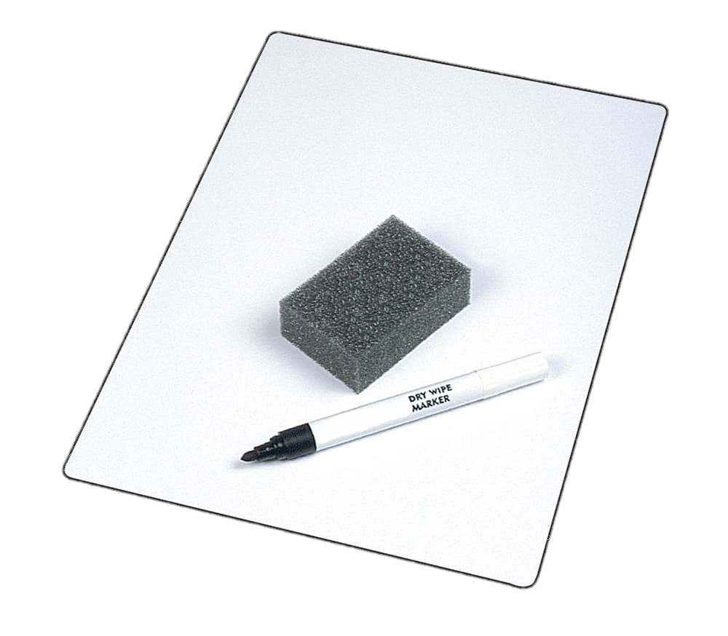
Starter– Geography quiz!
WALT: Understand, with support, most of the detail of an argument in short and extended texts.
On your whiteboards write the answers to these 5 questions.

Slide 5

Question 1:
WALT: Understand, with support, most of the detail of an argument in short and extended texts.
Is London an example of a district, town or city?

Slide 6
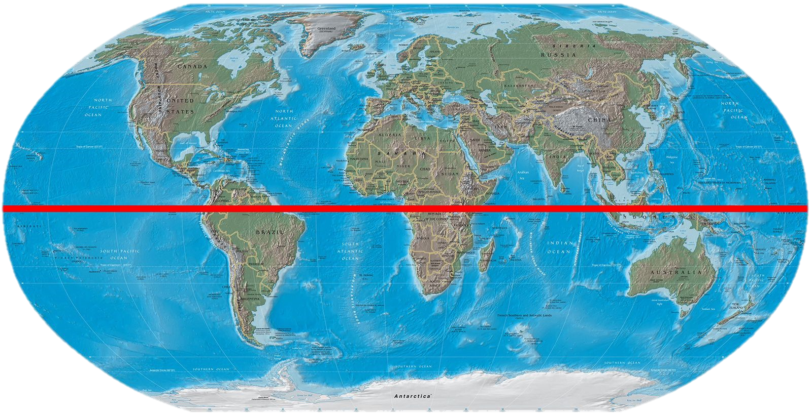
Question 2:
WALT: Understand, with support, most of the detail of an argument in short and extended texts.
What do we call the imaginary line that runs around the middle of Earth?

Slide 7
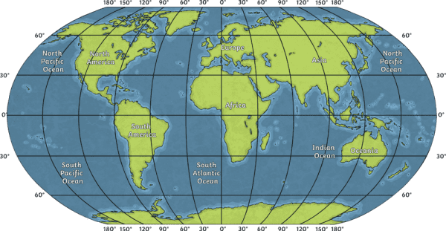
Question 3:
WALT: Understand, with support, most of the detail of an argument in short and extended texts.
Do lines of longitude run horizontally or vertically?

Slide 8
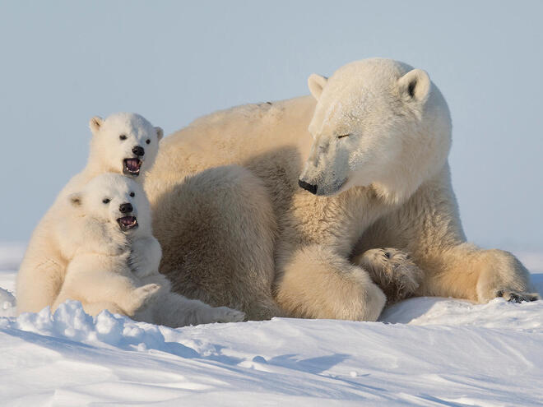
Question 4:
WALT: Understand, with support, most of the detail of an argument in short and extended texts.
What is the most northern point of Earth called?

Slide 9
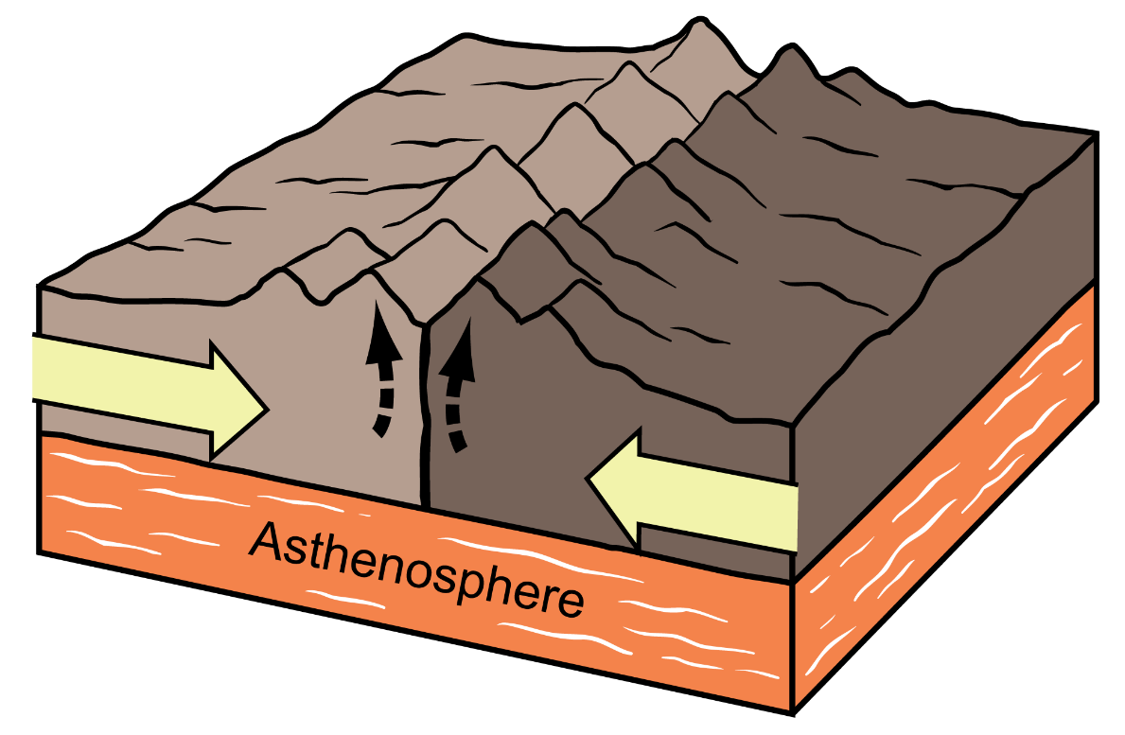
Question 5:
WALT: Understand, with support, most of the detail of an argument in short and extended texts.
Which of the following is not a continent?
Asia
The Middle East
Africa

Slide 10
WALT: Understand, with support, most of the detail of an argument in short and extended texts.
Answers!
City
The Equator
Vertically
The North Pole
The Middle East

Slide 11

How can we tell people where in the world we are?
WALT: Understand, with support, most of the detail of an argument in short and extended texts.

Slide 12
Look at this address of Vinschool Metropolis.
WALT: Understand, with support, most of the detail of an argument in short and extended texts.
29 P. Liễu Giai, Ngọc Khánh, Ba Đình, Hà Nội, Việt Nam
Which part of the address is:
Local ?
National?
International?

Slide 13
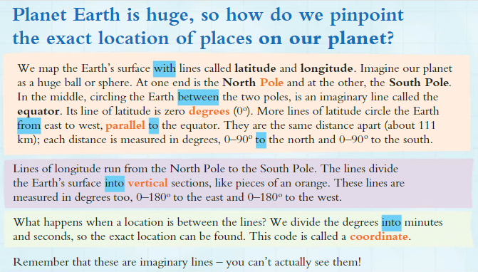
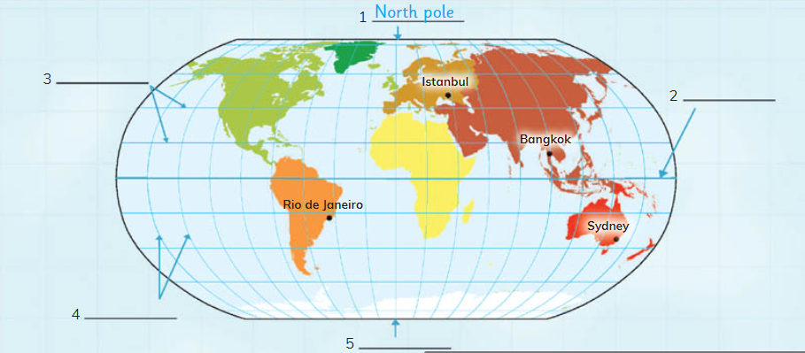
WALT: Understand, with support, most of the detail of an argument in short and extended texts.
Read the text independently now.
Page 15
LB

Slide 14
WALT: Understand, with support, most of the detail of an argument in short and extended texts.
Now let’s read it together.

Slide 15
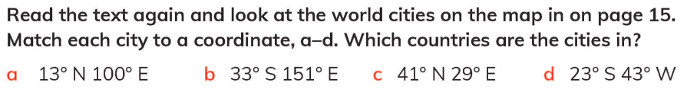
WALT: Understand, with support, most of the detail of an argument in short and extended texts.
Use the word bank to complete labels 2 – 5 on the world map.

Slide 16
WALT: Understand, with support, most of the detail of an argument in short and extended texts.
What imaginary line circles the Earth in the middle between the North and South Poles, and what is its degree measurement?
How far apart are lines of latitude from one another, and how far north and south are they measured?
What happens if a location is directly in between two-degree lines?
What is the code called that identifies an exact location, and can you see these lines on the actual surface of the Earth?

Slide 17
WALT: Understand, with support, most of the detail of an argument in short and extended texts.
Latitude
Equator
Longitude
South Pole

Slide 18



WALT: Understand, with support, most of the detail of an argument in short and extended texts.
Latitude
Equator
Longitude
South Pole

Slide 19
WALT: Understand, with support, most of the detail of an argument in short and extended texts.
The equator, which has a latitude of 0°.
2. They are about 111 km apart and are measured from 0°–90° to the north and 0°–90° to the south.
3. The degrees are divided into smaller units called minutes and seconds.
4. The code is called a coordinate, and the lines cannot be seen in real life because they are imaginary.

Slide 20
WALT: Understand, with support, most of the detail of an argument in short and extended texts.
I can use the key vocab to label a world map.
I can match world cities to their co-ordinates.
I can answer comprehension questions on a text.

Slide 21
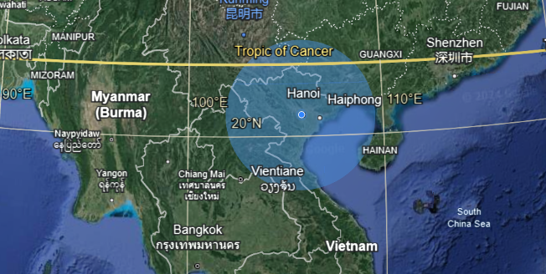
Plenary – Let’s see what interesting places in the world are on the same latitude and longitude as Hanoi.
WALT: Understand, with support, most of the detail of an argument in short and extended texts.
https://earth.google.com/web/@21.36054084,105.24218142,375.18837593a,543830.30304641d,35y,0.00026381h,0t,0r/data=OgMKATA

